Slide 1
Entry와 다양한 widget 활용 13주차_02_05
한 동 대 학 교 김경미 교수

Slide 2
학습목표
Entry widget 활용하기
file dialog와 color chooser 활용하기

Slide 3

Entry widget, 입력 받기 1
from tkinter import *
top = Tk()
L1 = Label(top, text="User Name")
L1.pack(side = LEFT)
E1 = Entry(top, bd =5)
E1.pack(side = RIGHT)
L2 = Label(top, text="Student ID")
L2.pack(side = LEFT)
E2 = Entry(top, bd =5)
E2.pack(side = RIGHT)
top.mainloop()

Slide 4
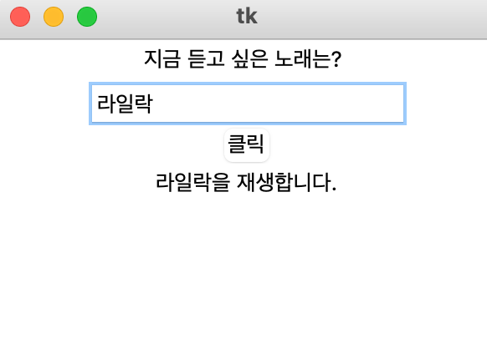
Entry widget, 입력 받기 2
from tkinter import *
from math import *
root = Tk()
root.geometry("300x200+100+100")
def press():
label2.configure(text = str(entry.get()) + "을 재생합니다." )
label1 = Label(root, text='지금 듣고 싶은 노래는? ')
label1.pack()
entry = Entry(root)
entry.pack()
button = Button(root, text = "클릭", command = press)
button.pack()
label2 = Label(root)
label2.pack()
root.mainloop()

Slide 5
Canvas widget
The Canvas widget uses two coordinate systems
the window coordinate system with (0, 0) in the upper left corner
(0, 0) → +
→
+

Slide 6
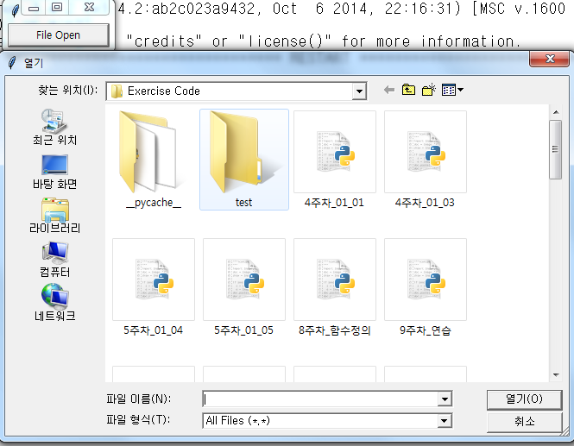
Dialogs: file dialog 1
#file dialog
from tkinter import *
from tkinter.filedialog import *
def callback() :
name= askopenfilename()
print(name)
errmsg = 'Error!'
Button(text='File Open', command=callback).pack(fill=X)
mainloop()

Slide 7
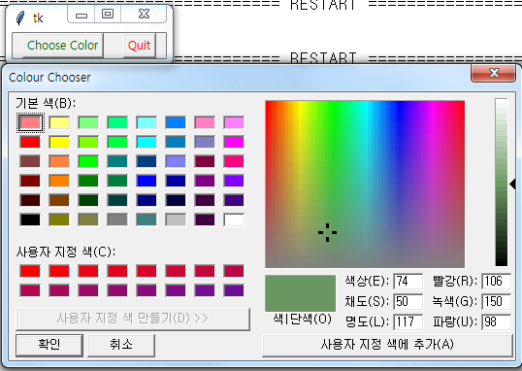
Dialogs: color chooser 1
from tkinter import *
from tkinter.colorchooser import *
def callback() :
result = askcolor(color="#6A9662", title = "Colour Chooser")
print(result)
root = Tk()
Button(root, text='Choose Color', fg="darkgreen", command=callback).pack(side=LEFT, padx=10)
Button(text='Quit', command=root.quit, fg="red").pack(side=LEFT, padx=10)
root.mainloop()

Slide 8
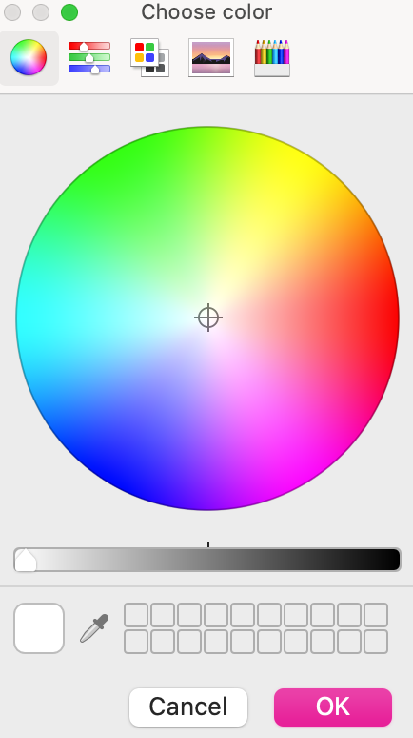
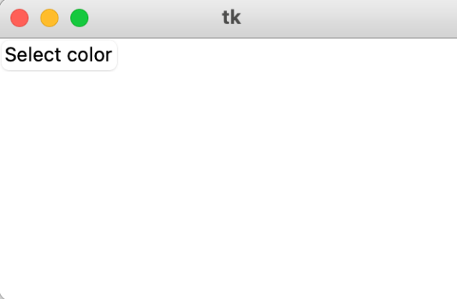

Dialogs: color chooser 2
from tkinter import *
from tkinter.colorchooser import *
root = Tk()
def choose_color():
color_code = askcolor(title ="Choose color")
print(color_code)
button = Button(root, text = "Select color",command = choose_color)
button.grid()
root.mainloop()

Slide 9
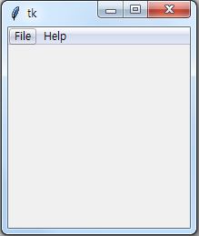
Creating menus 1
from tkinter import *
def NewFile() :
print("New File!")
def OpenFile() :
print("Open File!")
def About() :
print("This is a simple example of a menu")
root = Tk()
menu = Menu(root)
root.config(menu=menu)
filemenu = Menu(menu)
menu.add_cascade(label="File", menu=filemenu)
filemenu.add_command(label="New", command=NewFile)
filemenu.add_command(label="Open", command=OpenFile)
filemenu.add_separator()
filemenu.add_command(label="Exit", command=root.quit)
helpmenu = Menu(menu)
menu.add_cascade(label="Help", menu=helpmenu)
helpmenu.add_command(label="About...", command=About)
mainloop()

Slide 10
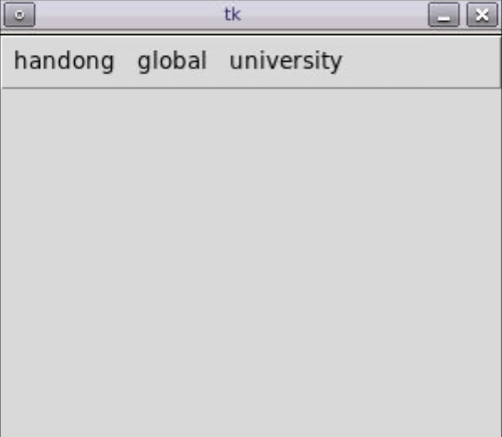
Creating menus 2
from tkinter import *
root=Tk()
root.geometry("300x300+100+100")
root.resizable(False, False)
def close():
root.quit()
root.destroy()
menubar=Menu(root)
menu_1=Menu(menubar, tearoff=0)
menubar.add_cascade(label="handong", menu=menu_1) menu_2=Menu(menubar, tearoff=0, selectcolor="red")
menubar.add_cascade(label="global", menu=menu_2) menu_3=Menu(menubar, tearoff=0)
menubar.add_cascade(label="university", menu=menu_3)
root.config(menu=menubar) root.mainloop()

Slide 11
연습문제 1 - file dialog
버튼 1,2 두개를 만든다.
버튼 1을 눌렀을 때, 현재 위치에 있는 hello1.txt파일의 내용을 읽어 출력하고,
버튼 2를 눌렀을 때, 현재 위치에 있는 hello2.py파일의 내용을 읽어 출력한다.

Slide 12
연습문제 1 코드
from tkinter import *
from tkinter.filedialog import *
root = Tk()
def press1():
file1 = askopenfile(initialdir='./',filetypes =(("Python files","*.py"),("txt files","*.txt")))
line1 = file1.readline()
label1 = Label(root, text=line1)
label1.grid()
def press2():
file2 = askopenfile(initialdir='./',filetypes =(("Python files","*.py"),("txt files","*.txt")))
line2 = file2.readline()
label2 = Label(root, text=line2)
label2.grid()
frame = Frame(root)
frame.grid()
btn1 = Button(root, text='버튼1', command=press1)
btn2 = Button(root, text='버튼2', command=press2)
btn1.grid()
btn2.grid()
root.mainloop()
Notes:
실행파일

Slide 13
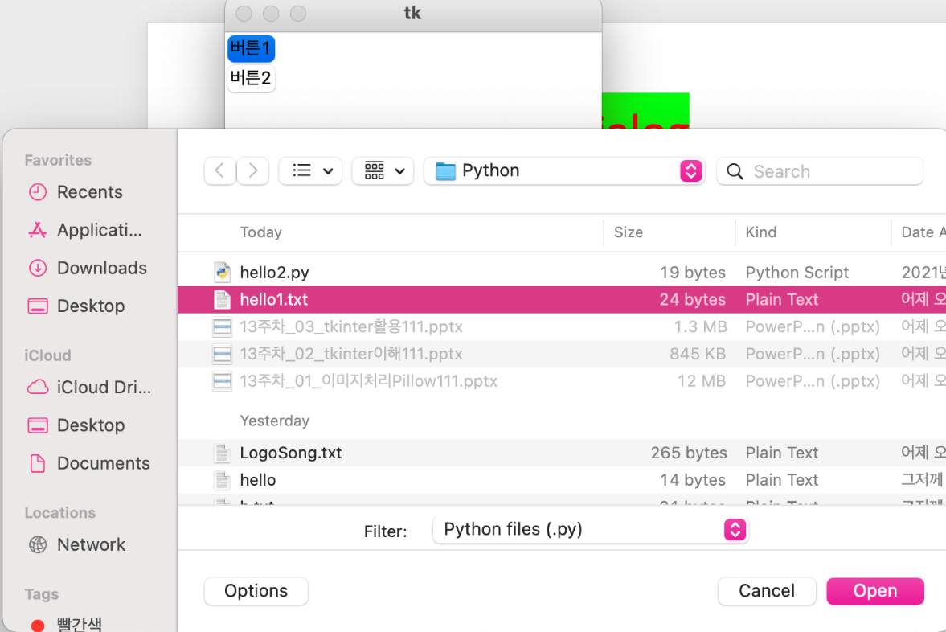
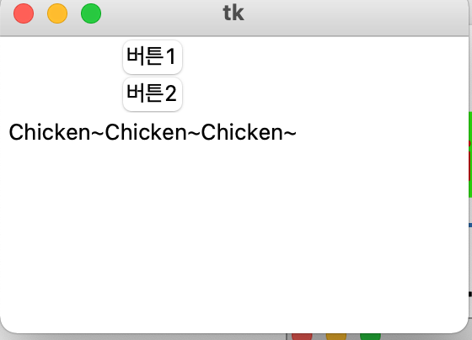
연습문제 1 결과
Notes:
실행파일

Slide 14
연습문제 2
그림판 만들기
색상 선택 하여 그리는 그림판을 만들면서
파일 열기, 저장 메뉴도 같이 만든다
Notes:
실행파일(그림판)

Slide 15
연습문제 2 코드 (1)
from tkinter import *
from tkinter.colorchooser import *
def NewFile() :
print("New File!")
def OpenFile() :
print("Open File!")
def About() :
print("This is a simple example of a menu")
root = Tk()
menu = Menu(root)
root.config(menu=menu)
filemenu = Menu(menu)
menu.add_cascade(label="File", menu=filemenu)
filemenu.add_command(label="New", command=NewFile)
filemenu.add_command(label="Open...", command=OpenFile)
filemenu.add_separator()
filemenu.add_command(label="Exit", command=root.quit)
Notes:
실

Slide 16
연습문제 2 코드 (2)
helpmenu = Menu(menu)
menu.add_cascade(label="Help", menu=helpmenu)
helpmenu.add_command(label="About...", command=About)
canvas = Canvas(root, width=500, height=500)
color = "red"
result = '#476042'
def callback() :
global result
result = askcolor(title = "Colour Chooser")
result = result[1]
button = Button(root, text='Choose Color', fg="darkgreen", command=callback)
button.pack(side=LEFT, padx=10)
lastx, lasty = 0, 0

Slide 17
연습문제 2 코드 (3)
def xy(event) :
global lastx, lasty
lastx, lasty = event.x, event.y
def addLine(event) :
global lastx, lasty
canvas.create_line((lastx, lasty, event.x, event.y), fill=result)
lastx, lasty = event.x, event.y
root.columnconfigure(0, weight=1)
root.rowconfigure(0, weight=1)
canvas.pack()
canvas.bind("<Button-1>", xy)
canvas.bind("<B1-Motion>", addLine)
root.mainloop()

Slide 18
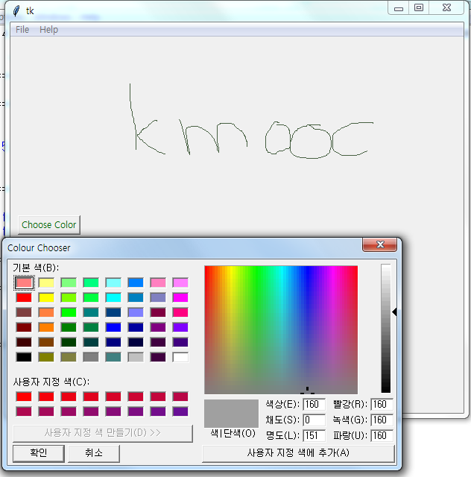
연습문제 2 결과
Notes:
실행

Slide 19
강의 요약
Entry widget 활용
file dialog와 color chooser 활용
file dialog: askopenfilename()
color chooser: askcolor()

Slide 20
목표 달성 질문
askcolor()를 사용하면 어떤 결과가 화면에 나타나는가?
askopenfilename() 를 사용하면 어떤 결과가 화면에 나타나는가?

Slide 21
감사합니다
13주차_02_05 Entry와 다양한 Widget 활용

